Slide 1

© 2007 Prentice Hall, Inc. All rights reserved.
7–<number>

Slide 2
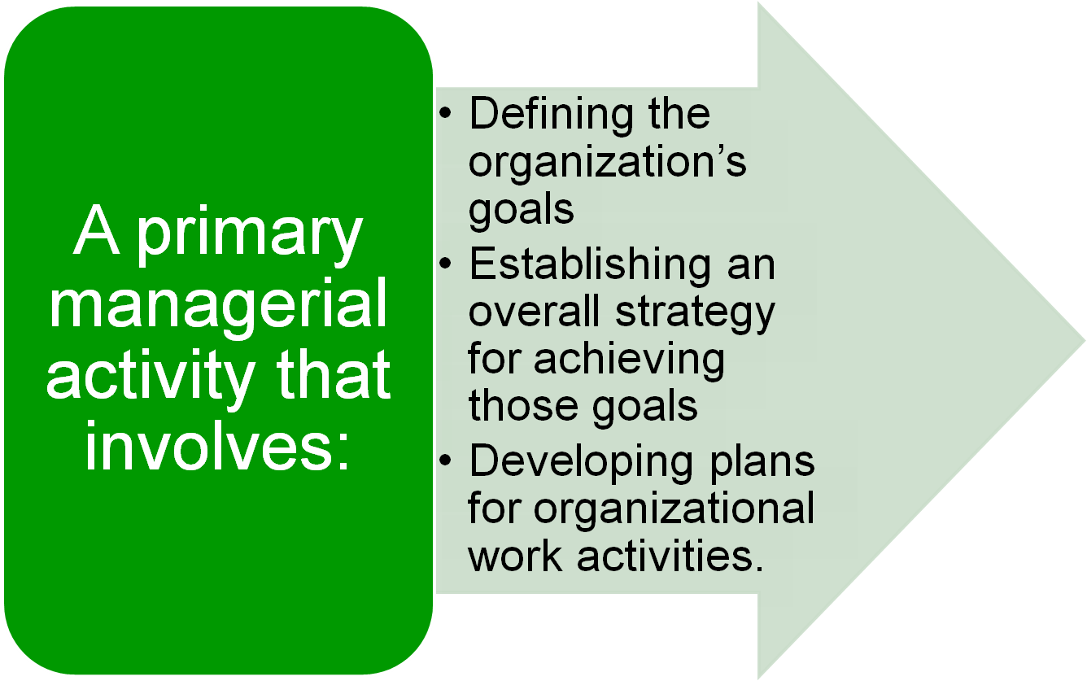
© 2007 Prentice Hall, Inc. All rights reserved.
7–<number>

Slide 3


  Provides direction
  Reduces uncertainty
  Minimizes waste and redundancy
  Sets the standards for controlling
© 2007 Prentice Hall, Inc. All rights reserved.
7–<number>

Slide 4

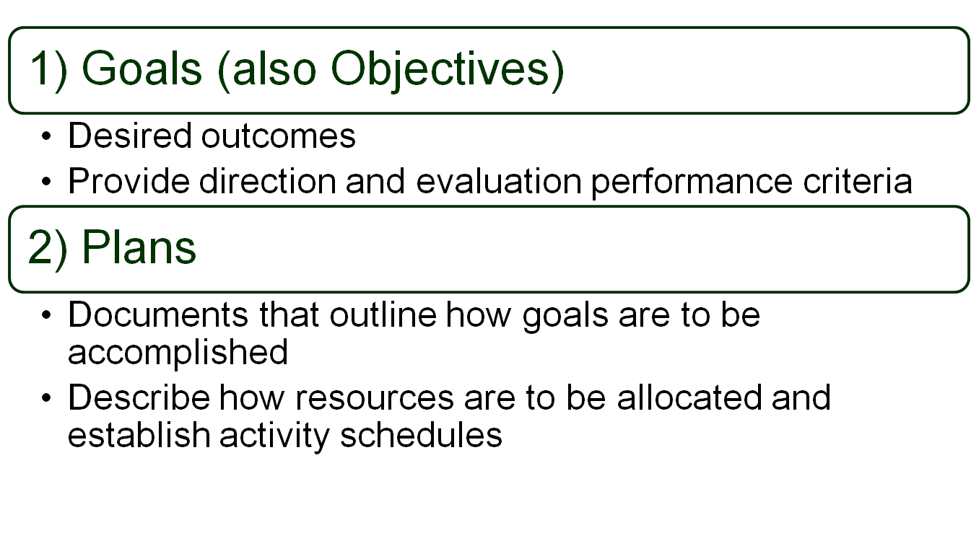
© 2007 Prentice Hall, Inc. All rights reserved.
7–<number>

Slide 5

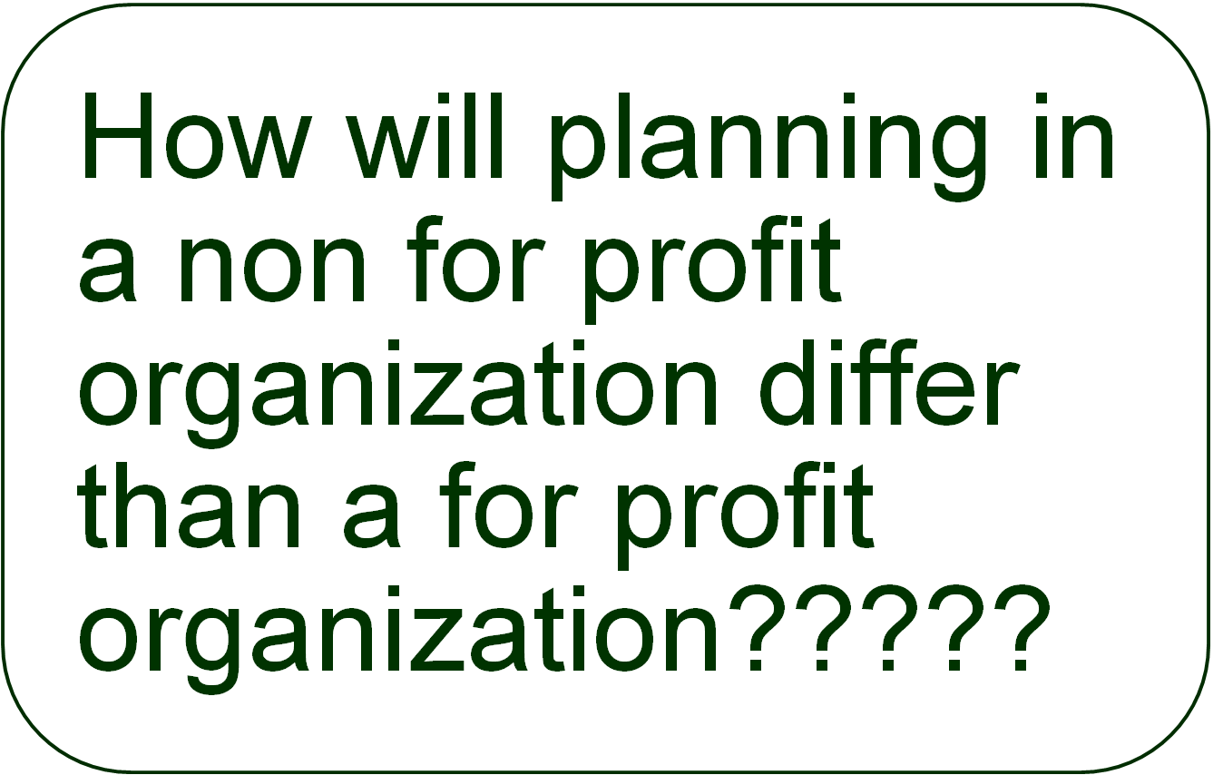
7–<number>

Slide 6
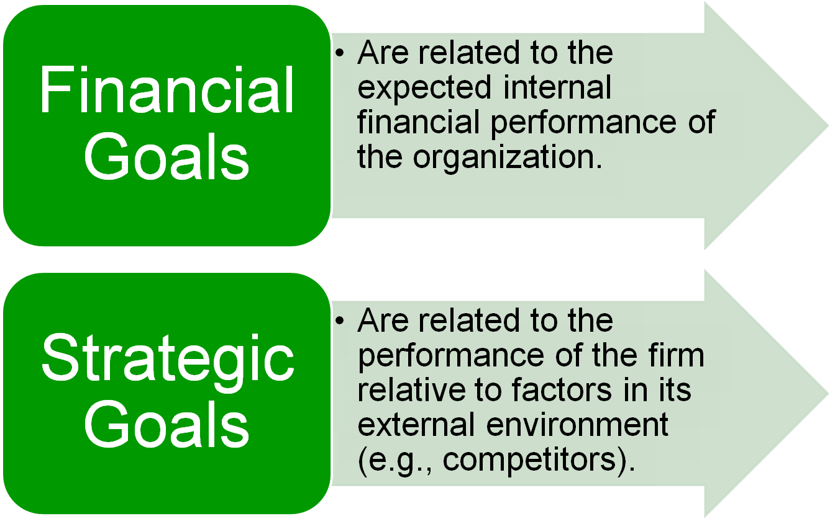
© 2007 Prentice Hall, Inc. All rights reserved.
7–<number>

Slide 7
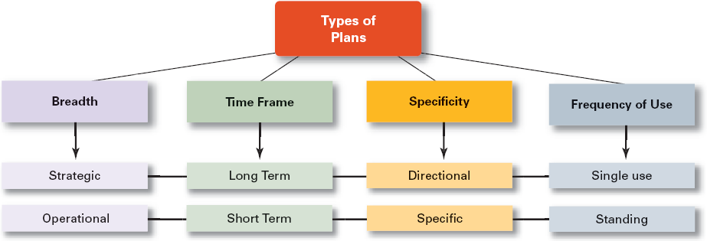
© 2007 Prentice Hall, Inc. All rights reserved.
7–<number>

Slide 8
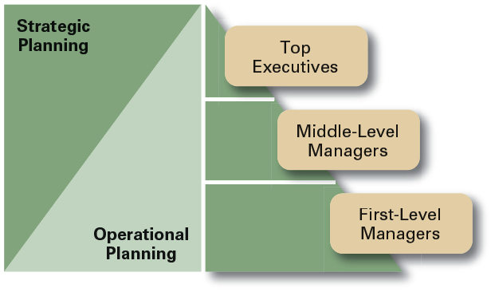
Types of Plans
Strategic Plans
  Apply to the entire organization.
  Establish the organization’s
  overall goals.
  Seek to position the organization in terms of its environment.
  Cover extended periods of time.
Operational Plans
  Specify the details of how the overall goals are to be achieved.
  Cover short time period.
7–<number>

Slide 9
Long-Term Plans
  Plans with time frames extending beyond three years
Short-Term Plans
  Plans with time frames on one year or less
Specific Plans
  Plans that are clearly defined and leave no room for interpretation
Directional Plans
  Flexible plans that set out general guidelines, provide focus, yet allow discretion in implementation.
© 2007 Prentice Hall, Inc. All rights reserved.
7–<number>

Slide 10
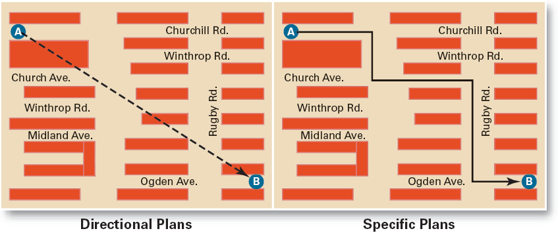
Exhibit 7–3 Specific Versus Directional Plans
© 2007 Prentice Hall, Inc. All rights reserved.
7–<number>

Slide 11
Single-Use Plan
  A one-time plan specifically designed to meet the need of a unique situation.
Standing Plans
  Ongoing plans that provide guidance for activities performed repeatedly.
© 2007 Prentice Hall, Inc. All rights reserved.
7–<number>

Slide 12
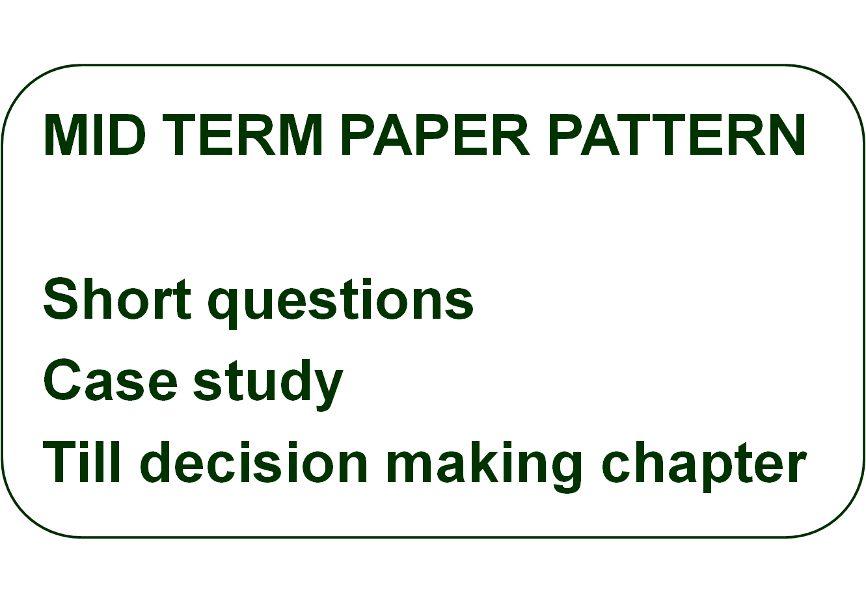
7–<number>

Slide 13

  Top of the organization.
  Goals ---subgoals
  Goals lose clarity and focus
© 2007 Prentice Hall, Inc. All rights reserved.
7–<number>

Slide 14
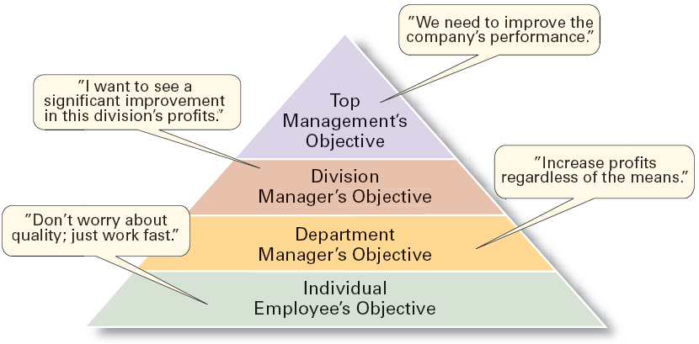
Exhibit 7–4 The Downside of Traditional Goal Setting
© 2007 Prentice Hall, Inc. All rights reserved.
7–<number>

Slide 15

Management By Objectives (MBO)
  Specific performance goals ----jointly determined by employees and managers.
  Periodically reviewed.
  Rewards allocated ----progress towards the goals.
  Key elements of MBO:
    Goal specificity, participative decision making, an explicit performance/evaluation period, feedback
© 2007 Prentice Hall, Inc. All rights reserved.
7–<number>

Slide 16
Does MBO Work?
Reason for MBO Success
  Top management commitment and involvement
Potential Problems with MBO Programs
  Not as effective in dynamic environments that require constant resetting of goals.
  Overemphasis on individual accomplishment may create problems with teamwork.
  Allowing the MBO program to become an annual paperwork shuffle.
© 2007 Prentice Hall, Inc. All rights reserved.
7–<number>

